Slide 1
Cooperative Inverse Reinforcement Learning (CIRL)
Dylan Hadfield-Menell, Anca Dragan, Pieter Abbeel, Stuart Russell
Neurips 2016

Slide 2


1
2
3
The CIRL Framework
Apprenticeship Learning and Paper Implementation
Our addition :
Using the CIRL structure
3
11
19

Slide 3
I – The CIRL Framework

Slide 4
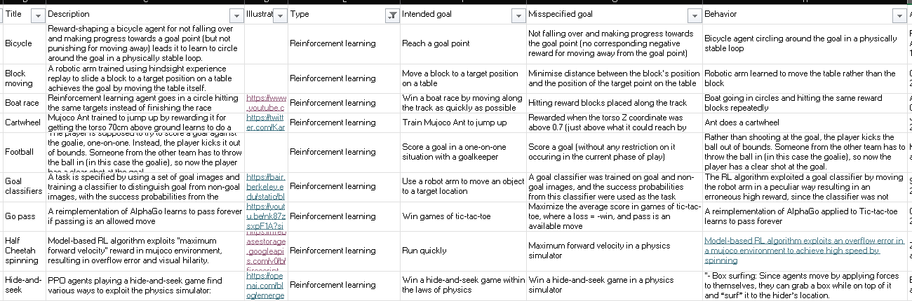
Context and Motivation
Reinforcement Learning : Maximizing reward function
Issue :
Alignment problems : the reward function sometimes doesn’t match the objective
Some value alignment problems in RL (Google Deepmind)

Slide 5





Reinforcement Learning
General setting
Inverse Reinforcement learning
Cooperative Inverse Reinforcement learning
Known rewards
Agent : computes optimal trajectory
Unknown rewards for the agent
Agent : estimates reward funciton from expert demonstration
Unknown rewards for the agent, known by the human
The human and agent collaborate to maximize a common reward
The human is incentivized to teach the reward
Need to know the reward
Not necessarily informative enough

Slide 6
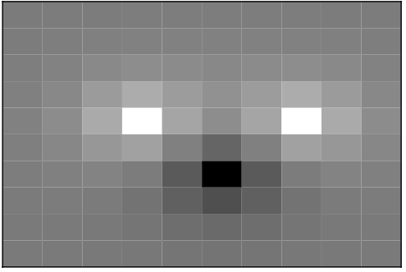
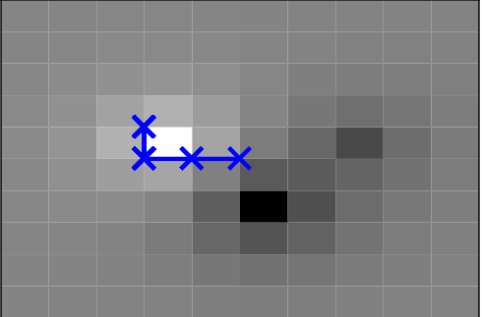
IRL and its limitations
Classic IRL: The robot observes a human acting optimally for a fixed reward function R(θ), then infers θ.
Limitation: IRL assumes the human acts optimally in isolation, not considering teaching or communication strategies.
The robot might not infer the correct theta, but only part of it
In this example, the robot knows where are the centers but doesn’t know the value associated
Reward distribution
Optimal behaviour

Slide 7



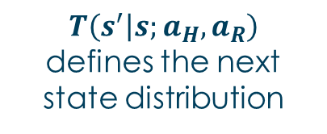



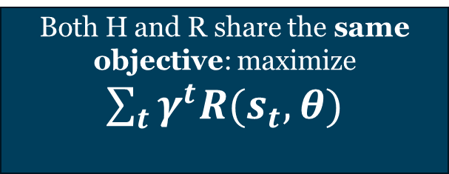
CIRL Framework
A CIRL game is a two-player, partial-information game
Sets of actions
State Space
Players
H
R
$$a_{H}∈A_{H}$$
$$a_{R}∈A_{R}$$
$$s∈S$$
Reward (only known to H)
Dynamics
Both H and R share the same objective: maximize $\sum_{t}{γ^{t}R(s_{t},θ)}$
$T\left(s^{′} | s;a_{H},a_{R}\right)$ defines the next state distribution
$$R(s,θ)$$
Notes:
Players: Human (H) and Robot (R).
State space: S.
Human knows θ∈Θ (the reward parameters); Robot does not.
Actions: $a_{H}∈A_{H}$​ (human’s action), $a_{R}∈A_{R}$​ (robot’s action).
Dynamics: $T\left(s^{′} | s;a_{H},a_{R}\right)$defines the next state distribution.
Reward: $R(s,θ)$known to H, unknown to R.
Both H and R share the same objective: maximize $\sum_{t}{γ^{t}R(s_{t},θ)}$

Slide 8
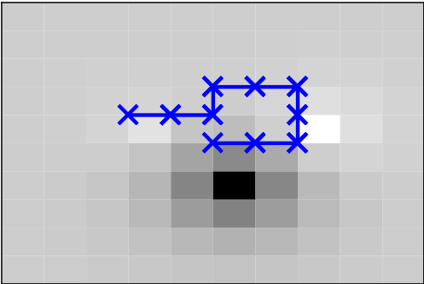
CIRL principles
CIRL Difference:
H and R cooperate.
H may act sub-optimally in terms of immediate reward to convey information about θ
R actively queries and interprets H’s behavior to improve its belief over θ.
Reward distribution
Instructive demonstration

Slide 9

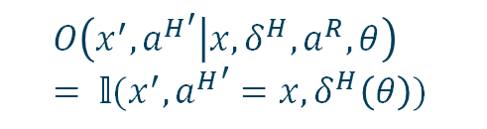
POMDP / coordination POMDP
POMDP :
State space
Observrvation space
Reward paramter space
Transition funciton
$$M^{′}=\{. X. , A , Z_{obs}. , O , Θ, R\left(. | .\right), T. , γ, P_{0}\}$$
Action space
Observrvation function
Reward function
coordPOMDP :
You observe the last human action and the state
The transition is analogous to the regularCIRL
$$M^{′}=\{(X.×Θ) , ({A^{H}}^{Θ}×A^{R}) , (X×A^{H}), O , Θ, R\left(. | .\right), T′ , γ, P_{0}\}$$
$$O\left(x^{′}, a^{H^{′}} | x, δ^{H}, a^{R},θ\right)= 𝕝(x^{′}, {a^{H}}^{′}={x,δ}^{H}\left(θ\right))$$
$$𝕝\left(θ^{′}=θ\right)T$$

Slide 10


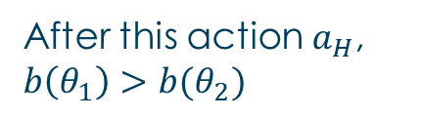
Belief update
A coordinator gives an action to the robot based on the belief $b(θ)$ and a decision rule to the human $δ^{H}\left(θ\right)=π^{H}(θ,h)$
$$θ_{1}$$
After this action $a_{H}$, $b\left(θ_{1}\right)>b(θ_{2})$
$$θ_{2}$$
Notes:
Computing an optimal joint policy ($π_{H}^{∗}$ , $π_{R}^{∗}$) in CIRL reduces to solving a coordination POMDP (partially observed Markov decision process) : the only piece of private information is θ.
The states are in $S×Θ$
A coordinator gives an action to the robot based on the belief $b(θ)$ and a decision rule to the human $δ^{H}\left(θ\right)=π^{H}(θ,h)$

Slide 11
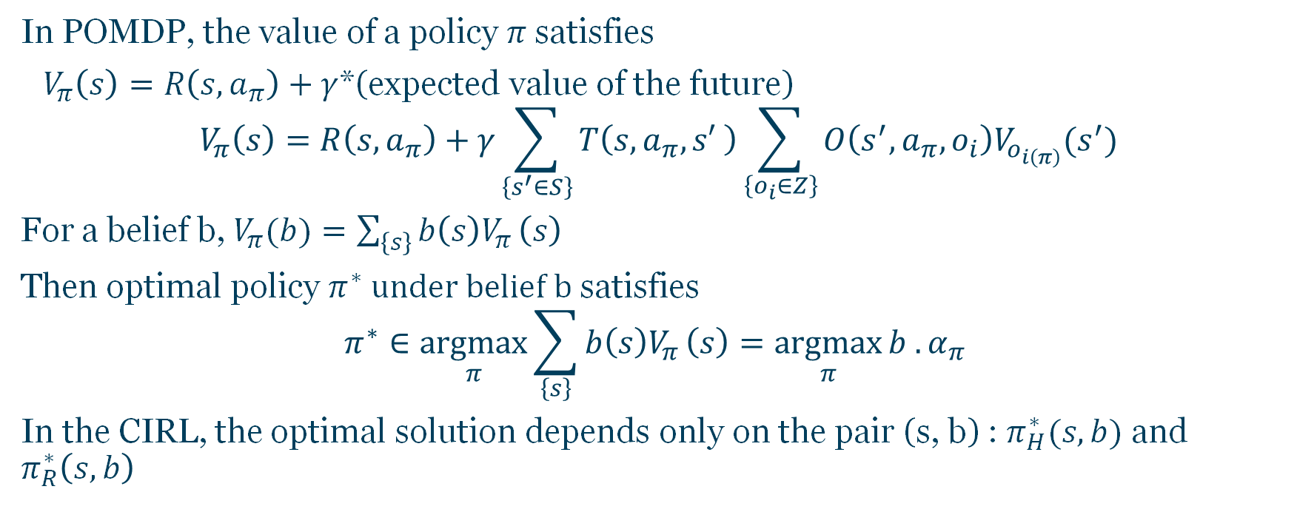
In POMDP, the value of a policy $π$satisfies
${ V}_{π}\left(s\right)=R\left(s,a_{π}\right)+γ$*(expected value of the future)
$$V_{π}\left(s\right)=R\left(s,a_{π}\right)+γ\sum_{\left\{s^{′}∈S\right\}}{T\left(s,a_{π},s′ \right)\sum_{\left\{o_{i}∈Z\right\}}{O\left(s^{′},a_{π},o_{i}\right)V_{o_{i\left(π\right)}}(s^{′})}}$$
For a belief b, $V_{π}(b)=\sum_{\left\{s\right\}}{b\left(s\right)V_{π}}\left(s\right)$
Then optimal policy $π^{∗} under belief b$satisfies
$$π^{∗}∈\underset{π}{argmax}{\sum_{\left\{s\right\}}{b\left(s\right)V_{π}}\left(s\right)=\underset{π}{argmax}{b . α_{π} }}$$
In the CIRL, the optimal solution depends only on the pair (s, b) : $π_{H}^{∗}(s,b)$ and $π_{R}^{∗}\left(s,b\right)$

Slide 12
II – Apprenticeship Learning & Paper Implementation

Slide 13
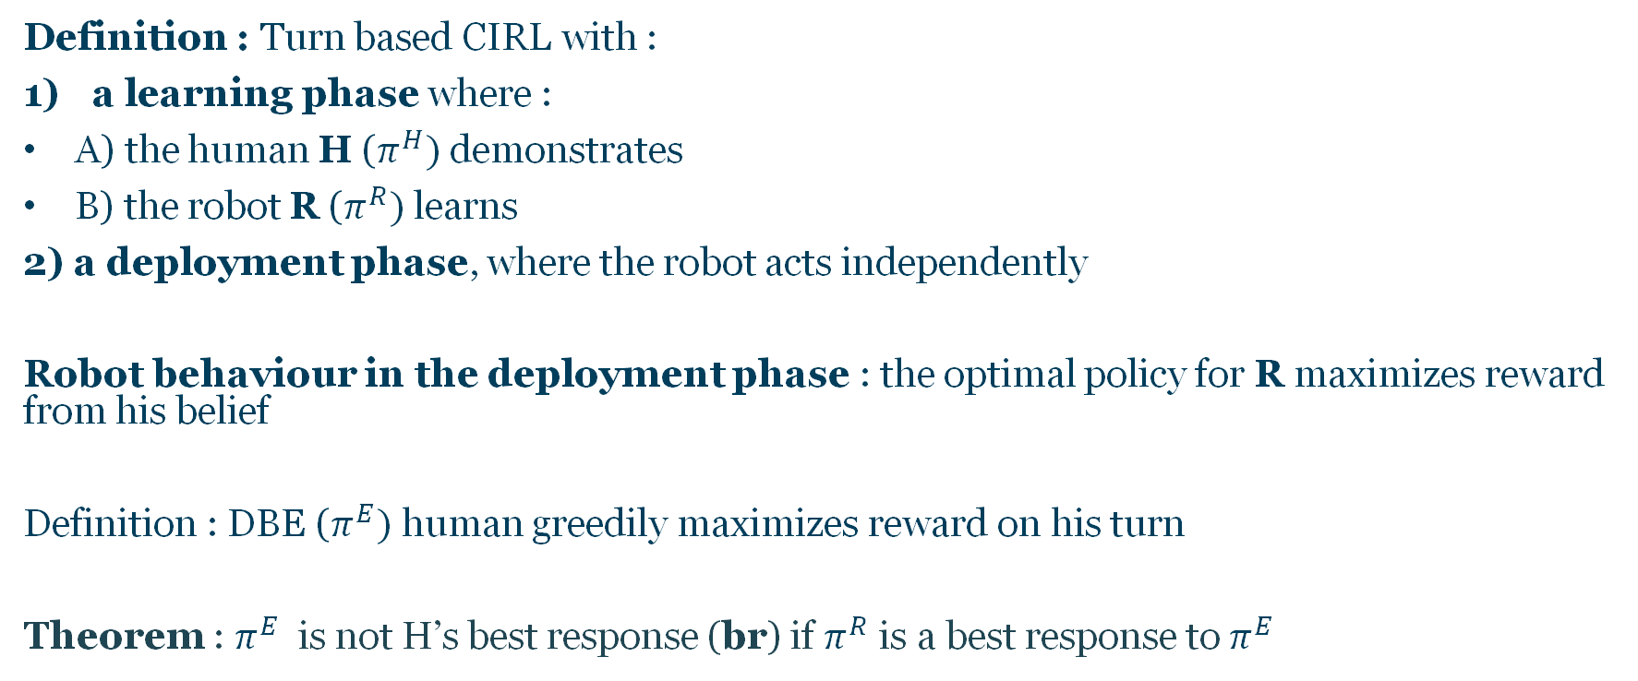
Apprenticeship Learning as a subclass of CIRL
Definition : Turn based CIRL with :
a learning phase where :
A) the human H ($π^{H})$demonstrates
B) the robot R ($π^{R})$learns
2) a deployment phase, where the robot acts independently
Robot behaviour in the deployment phase : the optimal policy for R maximizes reward from his belief
Definition : DBE ($π^{E})$ human greedily maximizes reward on his turn
Theorem : $π^{E}$ is not H’s best response (br) if $π^{R}$ is a best response to $π^{E}$

Slide 14
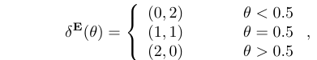
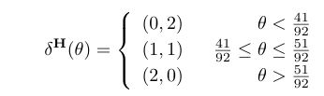
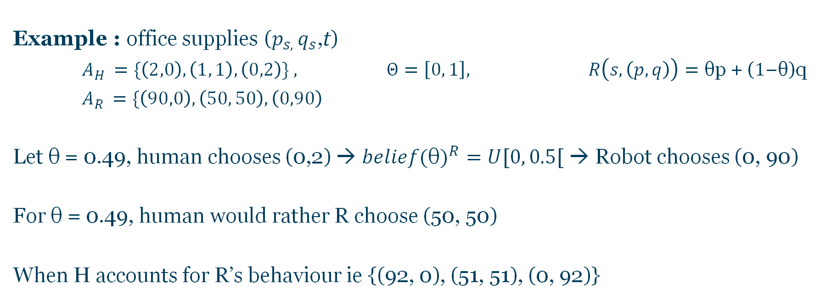
Apprenticeship Learning as a subclass of CIRL
Example : office supplies ($p_{s, }q_{s}$,t)
$A_{H }=\{\left(2,0\right), \left(1, 1\right), \left(0,2\right)\} , Θ=\left[0, 1\right], R\left(s, \left(p, q\right)\right)=\text{θ}\text{p}\text{ + (}1\text{−}\text{θ}\text{)}\text{q}$
$A_{R }=\{\left(90,0\right), \left(50, 50\right), \left(0,90\right)$
Let $\text{θ}$ = 0.49, human chooses (0,2) → ${belief(\text{θ})}^{R}=U[0, 0.5[$ → Robot chooses (0, 90)
For $\text{θ}$ = 0.49, human would rather R choose (50, 50)
When H accounts for R’s behaviour ie {(92, 0), (51, 51), (0, 92)}

Slide 15

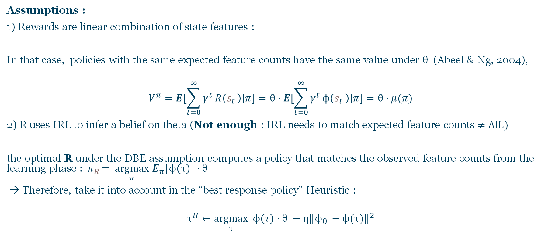
Generating Instructive Demonstrations
Assumptions :
1) Rewards are linear combination of state features :
In that case, policies with the same expected feature counts have the same value under $θ$ (Abeel & Ng, 2004),
$$V^{π}=E[\sum_{t=0}^{∞}{γ^{t}}R\left(s_{t }\right)\left|π]\right.=θ∙E[\sum_{t=0}^{∞}{γ^{t}}ϕ\left(s_{t }\right)\left|π]=θ∙μ(π)\right.$$
2) R uses IRL to infer a belief on theta (Not enough : IRL needs to match expected feature counts ≠ AIL)
the optimal R under the DBE assumption computes a policy that matches the observed feature counts from the learning phase : ${ π}_{R }= \underset{π}{argmax}$ $E_{π}[ϕ\left(τ\right)]∙θ$
→ Therefore, take it into account in the “best response policy” Heuristic :
$$τ^{H}←\underset{τ}{argmax}{ ϕ\left(τ\right)∙θ {− η\left\|ϕ_{θ }−ϕ(τ)\right\|}^{2}}$$
$$ϕ :R\left(s, a^{H},a^{R}, θ\right)=ϕ\left(s\right)∙θ$$
Sum of rewards
for the human
Feature dissimilarity

Slide 16
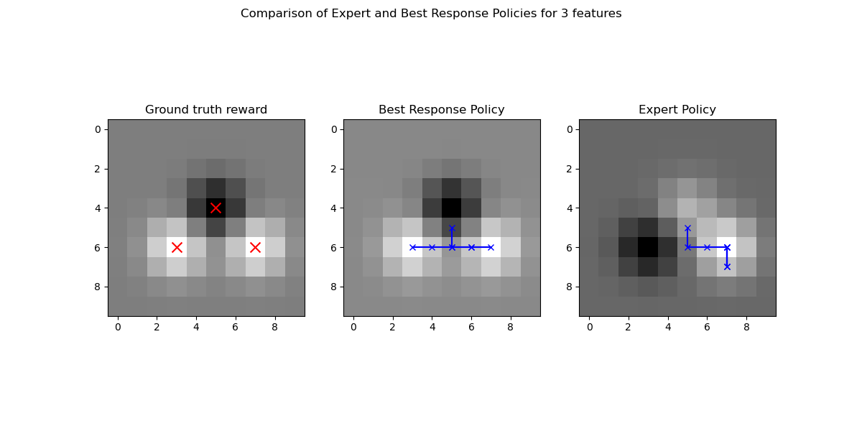
Implementing Apprenticeship Learning : Robot Gridworld
Images de notre implémentation et analyse

Slide 17
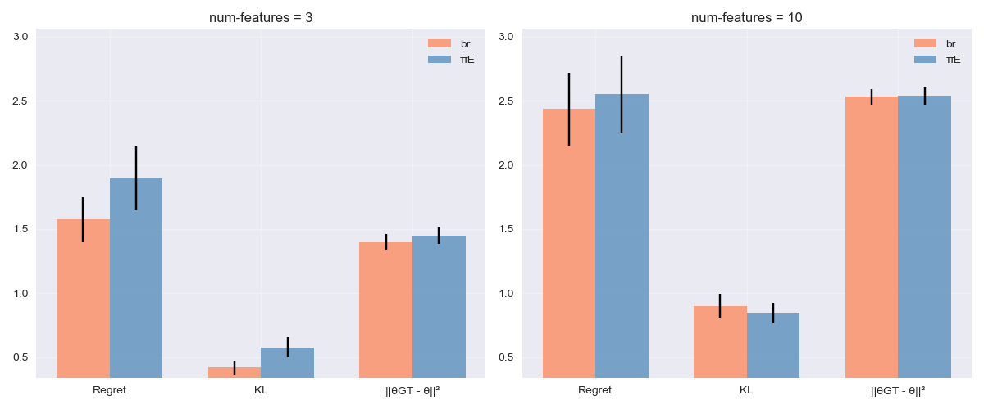
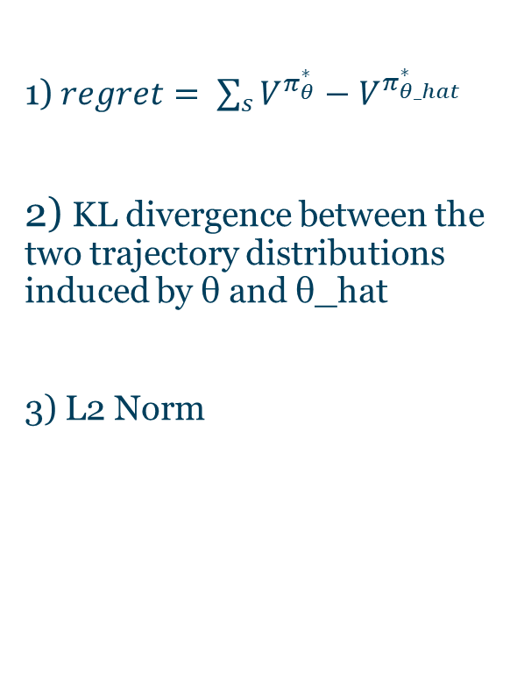
Best Response vs Expert : Analysis
1) $regret= \sum_{s}{V^{π_{θ}^{∗}}−V^{π_{θ_hat}^{∗}}}$
2) KL divergence between the two trajectory distributions induced by θ and θ_hat
3) L2 Norm
Notes:
KL-divergence between the maximum-entropy trajectory distribution induced by theta and the maximum-entropy trajectory distribution induced by theta_hat

Slide 18
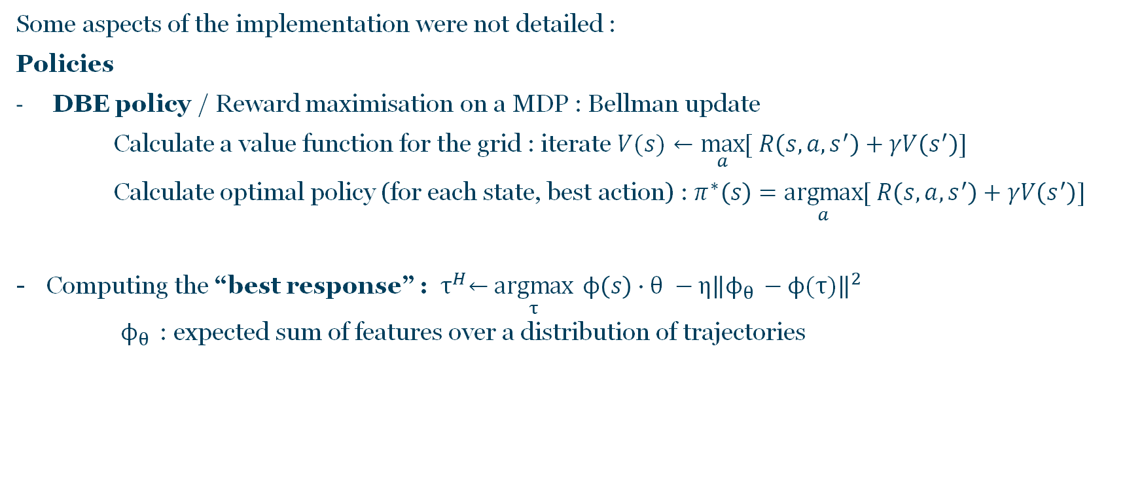
Apprenticeship Learning : Implementation details
Some aspects of the implementation were not detailed :
Policies
DBE policy / Reward maximisation on a MDP : Bellman update
Calculate a value function for the grid : iterate $V(s)←\max_{a}{[ R\left(s, a, s^{′}\right)+γV\left(s^{′}\right)]}$
Calculate optimal policy (for each state, best action) : $π^{∗}\left(s\right)=\underset{a}{argmax}{[ R\left(s, a, s^{′}\right)+γV\left(s^{′}\right)]}$
Computing the “best response” : ${ τ}^{H}←\underset{τ}{argmax}{ ϕ\left(s\right)∙θ {− η\left\|ϕ_{θ }−ϕ(τ)\right\|}^{2}}$
$ϕ_{θ }$ : expected sum of features over a distribution of trajectories

Slide 19
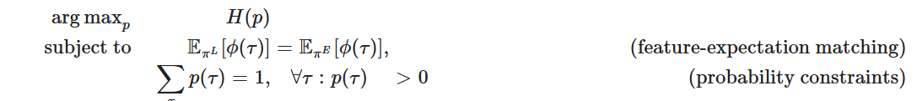
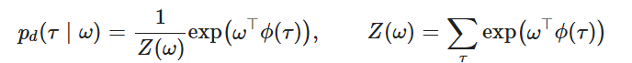
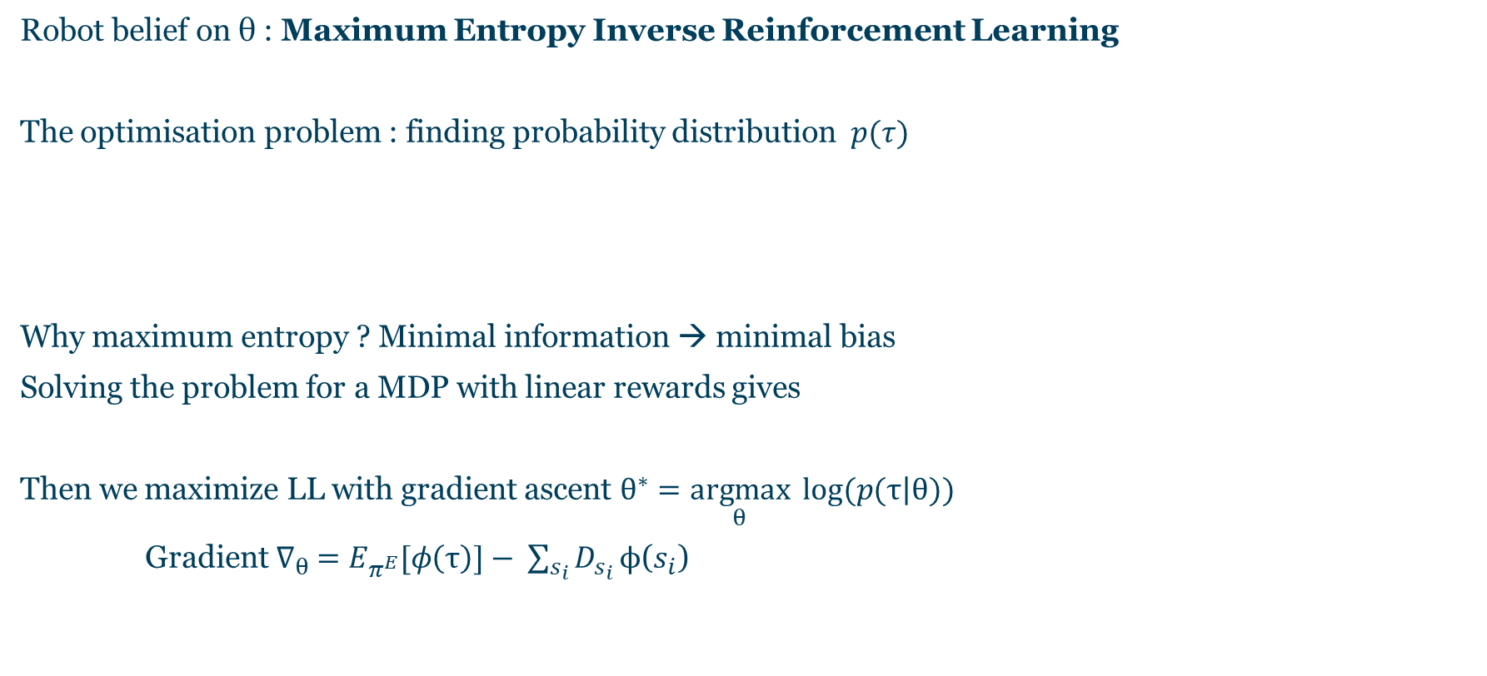
Apprenticeship Learning : Implementation details
Robot belief on θ : Maximum Entropy Inverse Reinforcement Learning
The optimisation problem : finding probability distribution$p(τ)$
Why maximum entropy ? Minimal information → minimal bias
Solving the problem for a MDP with linear rewards gives
Then we maximize LL with gradient ascent $θ^{∗}=\underset{θ}{argmax}{ log⁡(p(τ\left|θ))\right.}$
Gradient $∇_{θ} =E_{π^{E}}[φ\left(τ\right)]− \sum_{s_{i}}{D_{s_{i}}}ϕ\text{(}s_{i}$)
State visitation frequency

Slide 20
III – Our addition: Using the structure of the CIRL

Slide 21
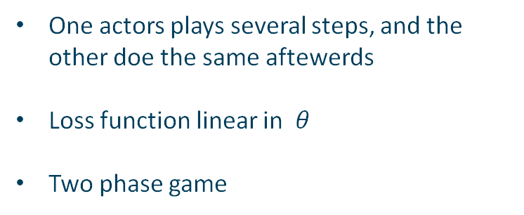
Limitations of the article
Theoretical framework
« Sub-case » developped
Both actors take an action at each step
Any loss function
The « robot » learns at each step
Optimal collabortation
One actors plays several steps, and the other doe the same aftewerds
Loss function linear in $θ$
Two phase game
$$⇒Let^{′}s work in a more general setting$$

Slide 22
Example of collaborative problem
0
T=1
Both player take actions at each step
Each action of the human uses the history to update the belief of the robot at each step
1
T=2
T=3
2
3

Slide 23

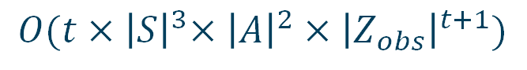

Solving a POMDP
Witness algorithm
Complexitty of a given POMDP
$$O(t{×\left|S\right|}^{3}×{\left|A\right|}^{2}×{\left|Z_{obs}\right|}^{t+1})$$
$$⇒$$
Exponential time complexity
Coordination POMDP
$$M^{′}=\{(X.×Θ) , ({A^{H}}^{Θ}×A^{R}) , (X×A^{H}), O , Θ, R\left(. | .\right), T′ , γ, P_{0}\}$$
$$O(t×{\left|X\right|}^{3}×{\left|Θ\right|}^{3}×{\left|A^{H}\right|}^{2\left|Θ\right|}×{\left|A^{R}\right|}^{2}×{\left|X\right|}^{t+1}×{\left|A^{H}\right|}^{t+1})$$
$$⇒$$
Prohibitively expensive even for small problems
Exponential complexity regarding the size of $Θ$as well

Slide 24


Improved algorithm
Dramatic complexity improvement possible !
Palaniappan, M., Malik, D., Hadfield-Menell, D., Dragan, A., & Russell, S. (2024). Efficient Cooperative Inverse Reinforcement Learning.
$$O(t×{\left|X\right|}^{3}×{\left|Θ\right|}^{3}×{\left|A^{H}\right|}^{2\left|Θ\right|}×{\left|A^{R}\right|}^{2}×{\left|X\right|}^{t+1}×{\left|A^{H}\right|}^{t+1})$$
Key ideas :
The only actor is the robot
Use the fact that the human knows everything (including the robot policy)
At each step, the human action is computed recursively, as the optimal way to influence the robot based on the conditional plan of the robot
Downside :
No detailed code available

Slide 25
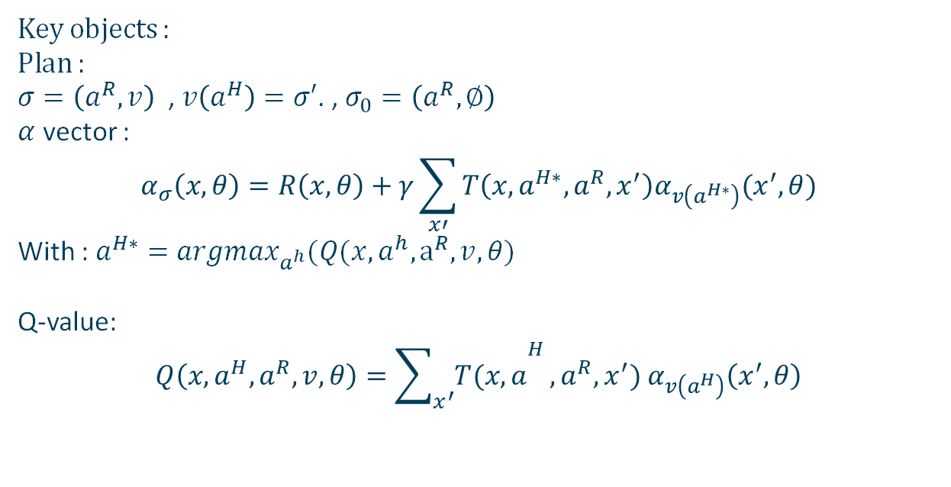
Our implementation
Any CIRL Problem :
(state space, actions, reward…)
Optimal joint policy
(step by step with both actors playing)
Our algorithm
Key objects :
Plan :
$σ=\left(a^{R}, v\right)$ , $v\left(a^{H}\right)=σ′$. , $σ_{0}=\left(a^{R}, ∅\right)$
$α$ vector :
$$α_{σ}\left(x, θ\right)=R\left(x, θ\right)+γ\sum_{x′}{T\left(x, a^{H∗}, a^{R}, x^{′}\right)α_{v\left(a^{H∗}\right)}(x^{′},θ)}$$
With : $a^{H∗}=argmax_{a^{h}}(Q(x, a^{h}, a^{R}, v, θ)$
Q-value:
$$Q\left(x, a^{H}, a^{R}, v, θ\right)={\sum_{x^{′}}{T(x, a}}^{H}, a^{R}, x^{′}) α_{v\left(a^{H}\right)}\left(x^{′}, θ\right)$$
Use of a recursive structure and Bellman udpates
Test on all possible plans, with pruning of sub-optimal plans at each step
Update of a value function at each step to help pruning
Outputs an optimal conditional plan regarding an initilal belief

Slide 26

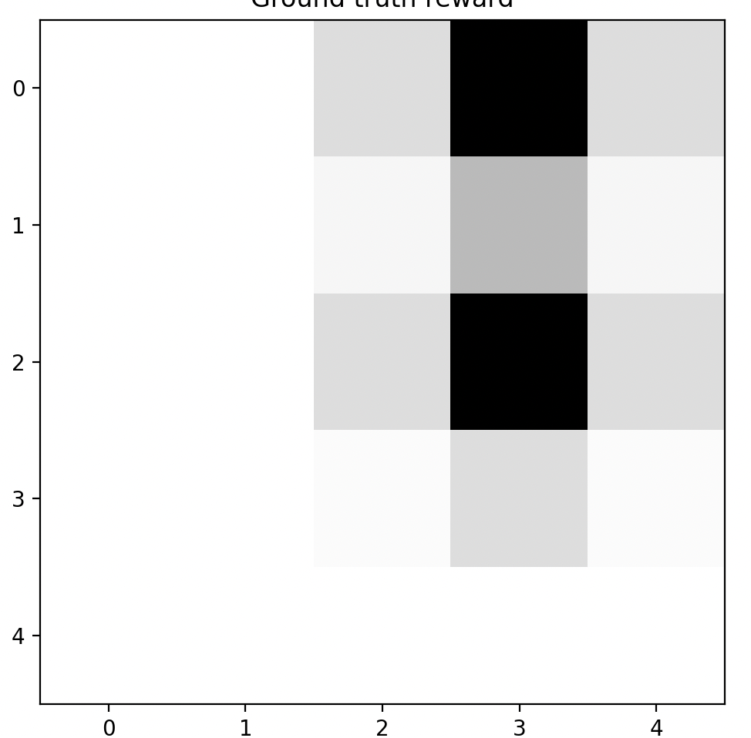
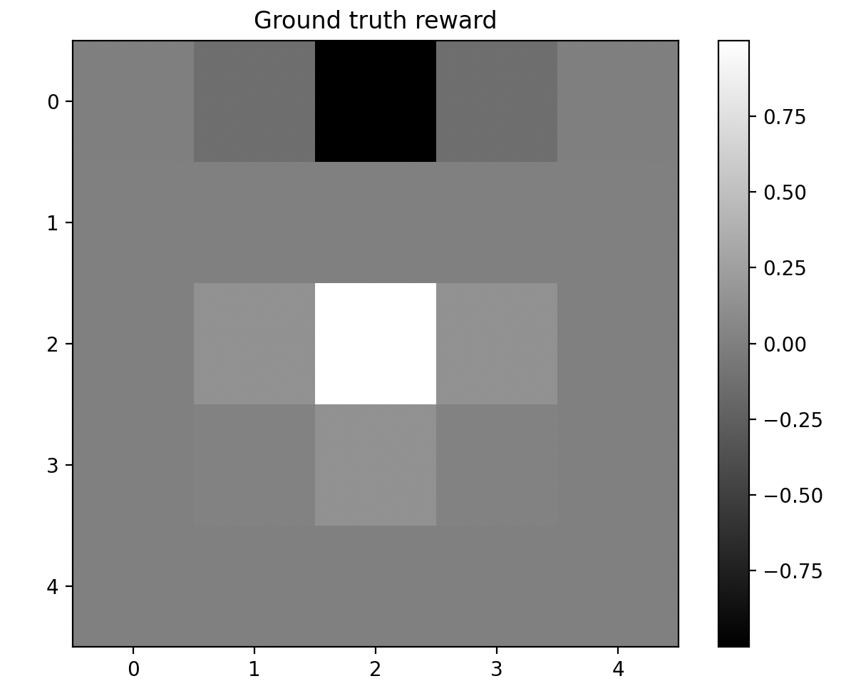
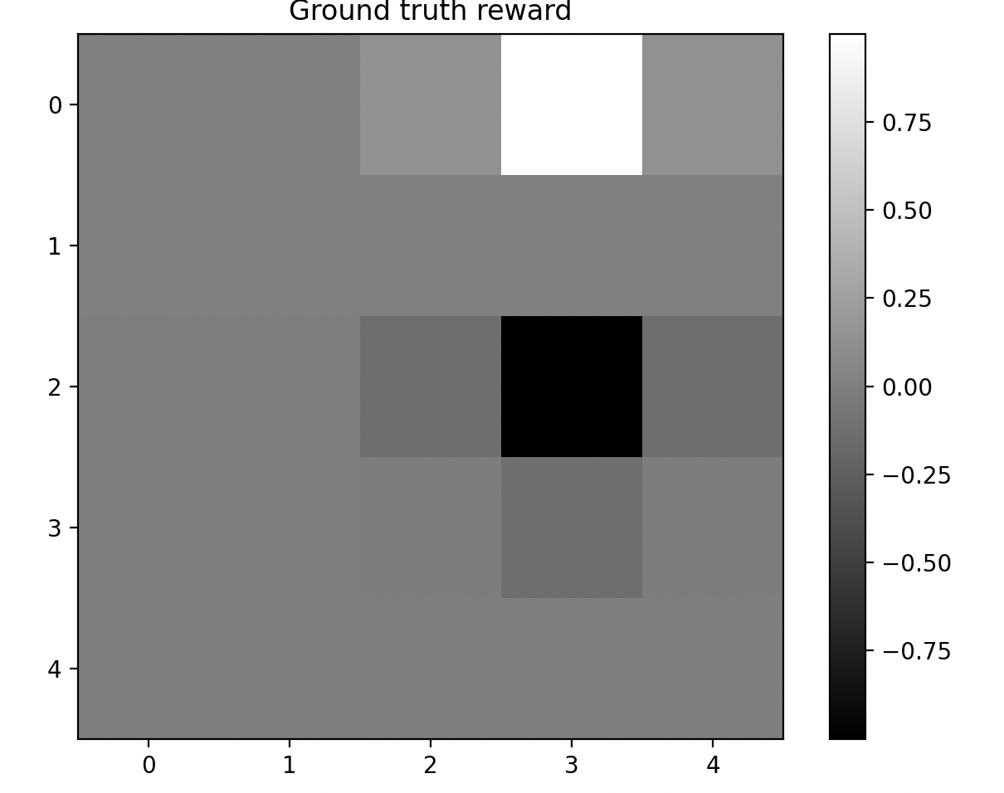


Results
Some other possible states
The algorithm gives the policy in which the robot will best adapt to optimal human feedback
True step by step problem
Example output

Slide 27
Summary
In the article
Our contribution
Highligted critical unstated hypotheses in the article
Reproduced and explained the paper experiments
Building on papers, found and implemented a more efficient reformulation of CIRL problems
Applied it to a problem that fully the theoretical framework of CIRL
Introduction of the CIRL framework
Reduction to a coordiantion POMPDP
Application to Apprenticeship learning
Very specific framework (linear reward)
Approximate method using a heuristic in this context

Slide 28
Applications of CIRL
Personal assistant, learning to help the user based on their preferences
Recommandation systems, learning the users preferences.

Slide 29
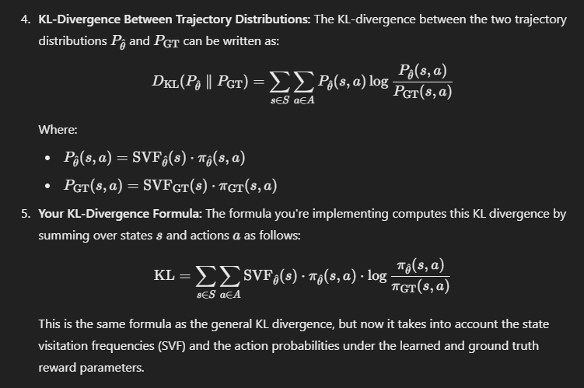
Annexes

